Slide 1

POSeidon’s infant
Val’s learnings
Valente Arroyo

Slide 2

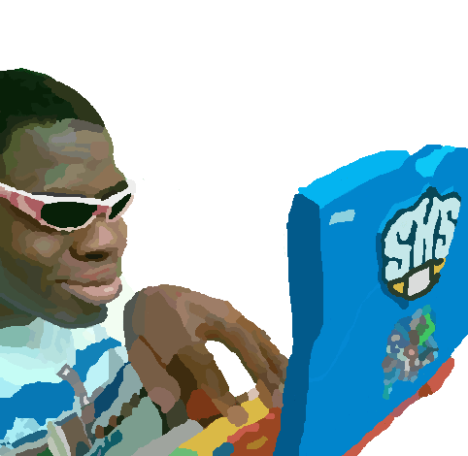
Introduction
My name is Valente Arroyo and I am on the POSeidon team!
I created an app to explain and show my learnings of these last 3 months
App allows others to view each of my learnings with possible questions
App is on personal Github!

Slide 3
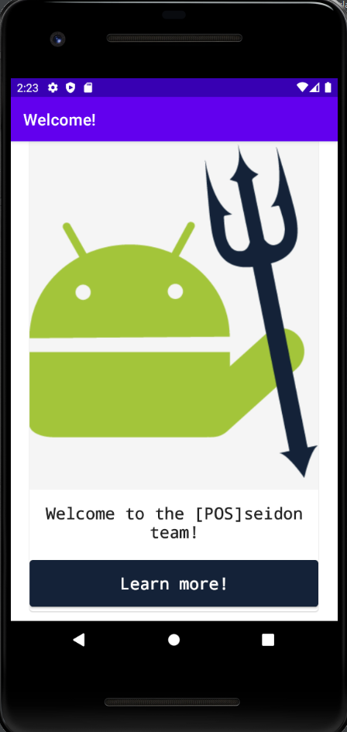
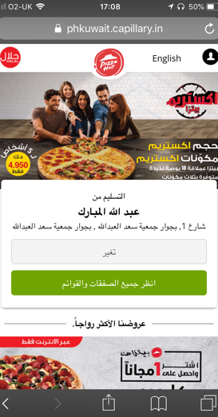
Contents of the app

Slide 4
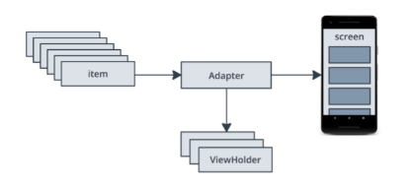
Components of code
Activity
Fragments
Recycler View
Adapters
Data classes
Notes:
Activity – Just as most code is launched with a main() method, the activity class in Android initiates the code needed to draw out the user interface
Fragments – reusable piece of the app’s interface , they can respond to user input and handles it own layout, multiple fragments can be hosted by a single activity
Recycler View – supports displaying a list items in different ways, such as a linear list or in grid format
Adapters – handles populating the recyclerview with the the items along with defining what the view for them is
Data classes – Kotlin provides auto generated 'equals', 'hashCode', 'toString' and 'copy' methods implementations for free by adding the 'data' modifier to the class and
can be defined as a models aka defining objects that we use, like a Product

Slide 5
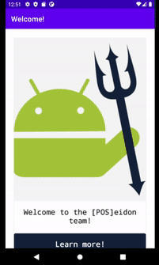
Contents and features
Intro to the app
Self introduction
Android
Kotlin
XML
View Binding
Git
Jira and Agile Development
MVVM Architecture
POS
Main screen contains the lesson name and picture
Button press takes you to a page of details
Details page contains possible questions and answers
Navigate the app by scrolling up and down

Slide 6
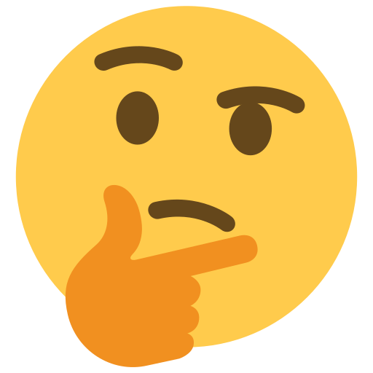



Future improvements
Hyperlinks page for each lesson
Table of contents button
Better UI design

Slide 7

Learnings/takeaways
01
02
03
04
05
Started off with 0 knowledge in Android Development
Applied all that I have learned and my own learning for the personal app
Don’t be afraid to ask questions!
App development not only relies on code, but UI design as well
Learned Software Development Lifecycle

Slide 8
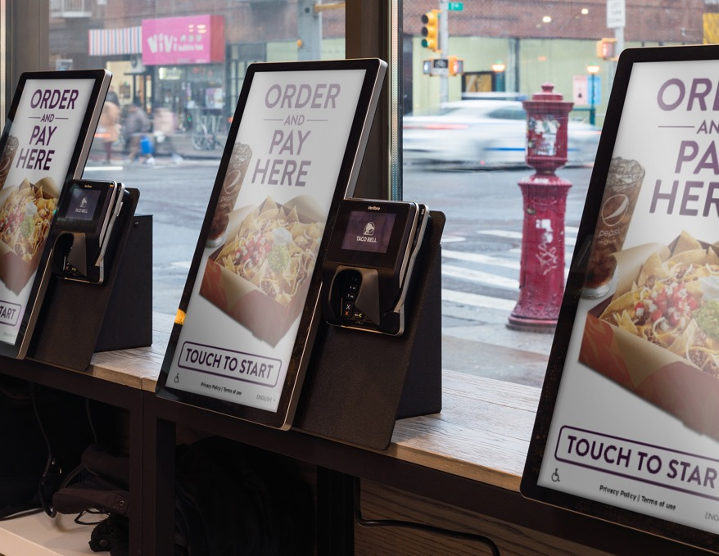

Let’s get into the app!

Slide 9

Thank you!
Notes:
From my perspective, what things have I learned, was it straight forward and such, Show how app was made and components
Outline of what I wanna do and look at slide and just start talking, start talking and
Do it a bunch, write a script and go over it
Practice, do bullets and just talk, if not write a script
Have a goal like I want to build somerhing in android with kotlin vs I want to learn kotlin

